Slide 1
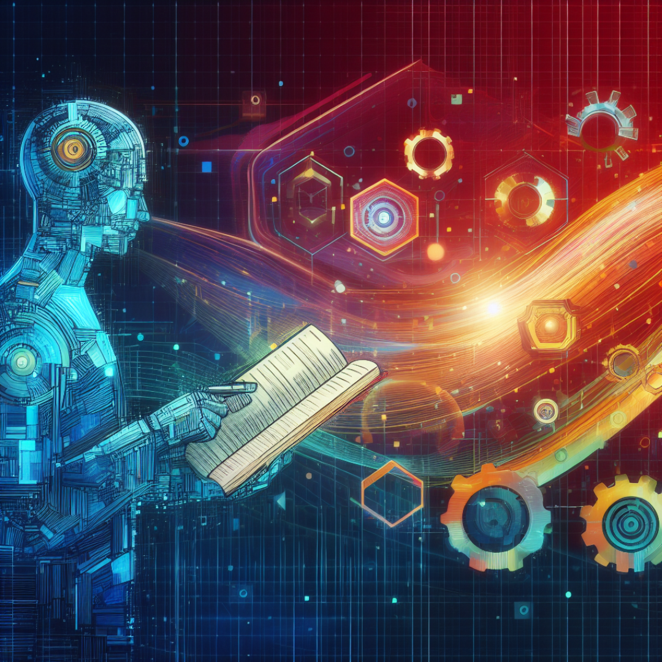
Knowledge Representation and Reasoning in Artificial Intelligence
What is KRR and Why is it Important?
KRR is the process of encoding and processing information about the world in a way that computers can understand and use.
KRR allows the machine:
Understand and interpret information: KRR provides a structured framework for organizing and encoding knowledge, allowing computers to comprehend the meaning and relationships between concepts.
Reason about the world: KRR empowers AI systems to make interpretations, draw conclusions, and solve problems based on their stored knowledge.
Learn and adapt: KRR facilitates the acquisition of new knowledge and the adaptation of existing knowledge to new situations, enabling AI systems to continuously improve their performance.

Slide 2
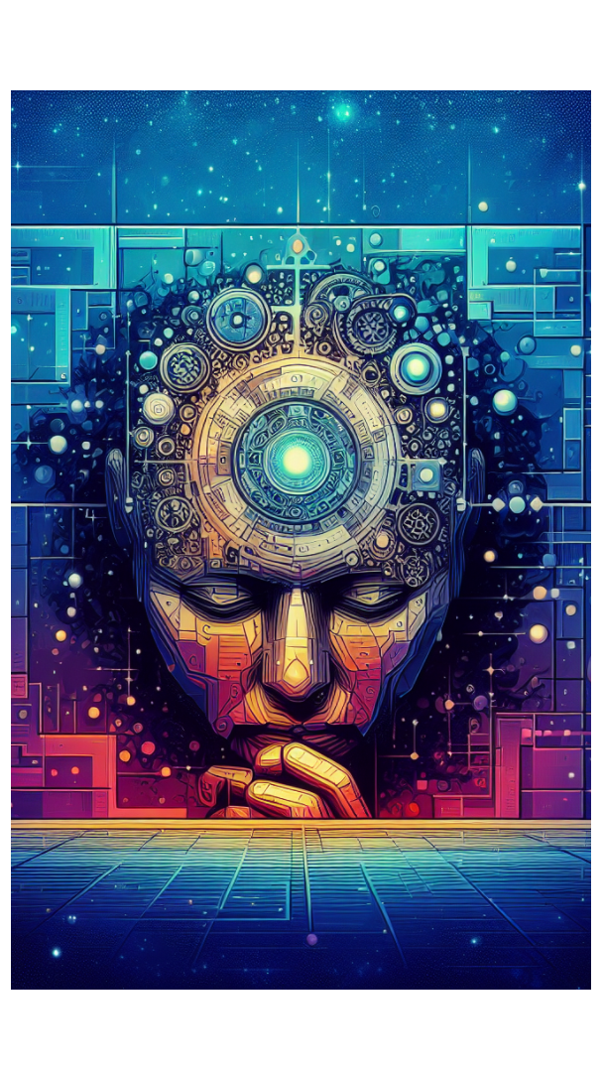

The two main components of KRR are:
Knowledge Representation
This involves encoding information about the world in a formal language that computers can comprehend. For example, you might represent a cat as a furry animal with four legs and a tail.
Knowledge Reasoning
This involves applying encoded knowledge to achieve specific goals or tasks. For example, a robot might use its knowledge of objects and their relationships to navigate its surroundings.

Slide 3
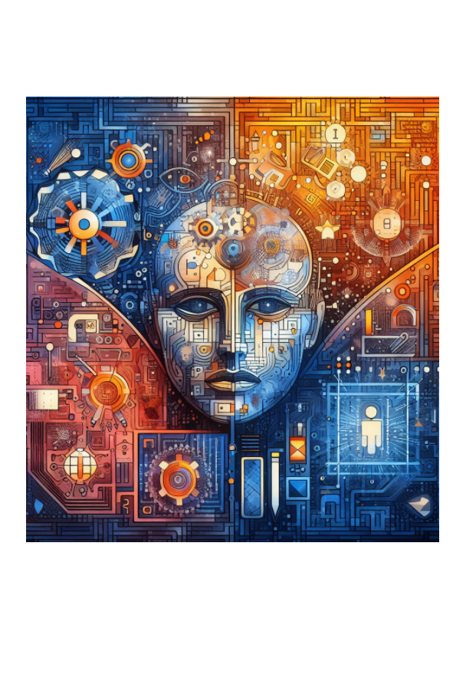
KRR is used in a wide range of AI applications, including:
Expert systems
These systems use knowledge bases to store and apply expertise in specific fields, such as medical diagnosis or legal analysis.
Natural language processing (NLP)
NLP systems use KRR to understand and generate human language, enabling tasks like machine translation or sentiment analysis.
Robotics and autonomous systems:
Robots and self-driving cars use KRR to perceive their surroundings, make decisions, and plan actions.
Machine learning
KRR performs a role in machine learning by providing representations for learning algorithms and interpreting the results.

Slide 4
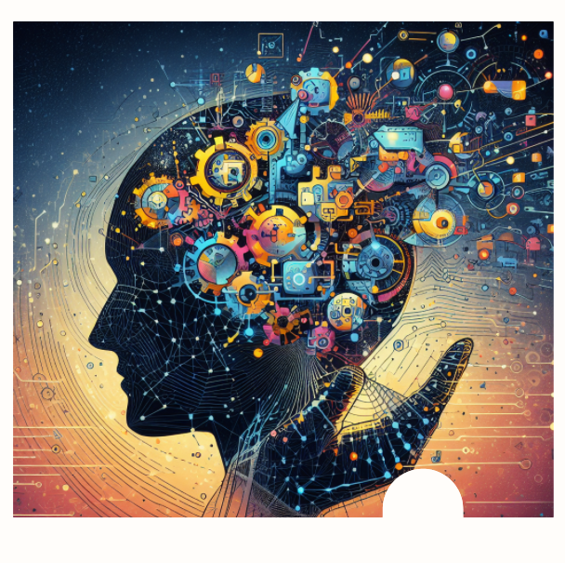
Despite its advancements,
KRR faces several challenges
such as:
Acquiring knowledge
Representing knowledge
Maintaining knowledge
Sharing knowledge
AI Computer Vision

